Slide 1

Lesson 5 Occupancy Grids (1) Probabilistic Modelling of a Sonar Sensor
AI for Mobile Robots:
Intelligent Mobile Robotics
Dr. Aboozar Taherkhani (PhD)
email: aboozar.taherkhani@dmu.ac.uk

Slide 2
Overview
The occupancy grid
Modeling a sonar sensor
Maths
Implementation details

Slide 3
The Occupancy Grid
The scattergram in the previous lesson is binary:
A point in space is either occupied or not
Range readings are determenestics
However there are uncertainties:
Wind
Humidity
Obstacle material properties
Occupancy grids attempt to mitigate some of these uncertainities

Slide 4
The Occupancy Grid
Divide mapping area into a grid

Slide 5
The Occupancy Grid
Grid size is proportional to computational complexity:
How big is the area you are working in?
5m X 5m
Let a grid square cover 5cm X 5cm area
100 x 100 squares
10000 squares

Slide 6
The Occupancy Grid
So each grid square represents an area of some size
Each square is assigned a probability
This is the probability that the square is occupied
0 = definitely not occupied (white)
1 = definitely occupied (black)
0.5 = Equal chance of being occupied or unoccupied (grey)
All squares are initialised to 0.5

Slide 7
The Occupancy Grid
Initial occupancy grid

Slide 8
The Occupancy Grid
But how do we update it?
Sonar reading

Slide 9
Sonar Model
Why do we need a sonar model?
Readings are inaccurate
Say we get a reading at (22.2,43.2) at a heading 70°
A probabilistic model of the sonar allows us to model the inaccuracies
We can ask the questions like:
Given the reading, what is the probability that there is an obstacle at (21.2,42.1)?
General question:
Given the potential for uncertainty in the sonar reading at P what do I know about Q?

Slide 10
Sonar Model
P
Q

Slide 11
Sonar Model
We need a model of a sonar sensor
But what should its properties be?

Slide 12
Sonar Model
We need a model of a sonar sensor
But what should its properties be?
Region 1
The area immediately around the sonar reading
Grid squares in this area have a probability of 1
To mark the obstacle taking into account:
Uncertainty in the distance reading
Uncertainty in angle

Slide 13
Sonar Model
Simplest model
3
1
2

Slide 14
Sonar Model
The area in between the sonar and obstacle should be free of obstacles
Grid squares in this area have a probability of 0
This is region 2
The area in on the other side of obstacle we have no knowledge of
Grid squares in this area have a probability of 0.5
This is region 3

Slide 15
Sonar Model
Simplest model
3
1
2

Slide 16
Sonar Model
Simplest model
3
1
2

Slide 17
Sonar Model
Simplest model
P
1
0
2
1
3
Dist

Slide 18
Sonar Model
Improving this model
3
Tend to 0.5
1
2
Tend to 0.5

Slide 19
Sonar Model
More complex model
P
1
0
2
1
3
Dist

Slide 20
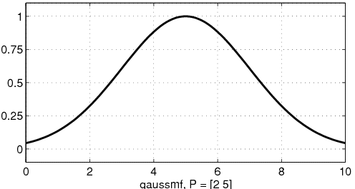

Sonar Model
Some useful functions

Slide 21
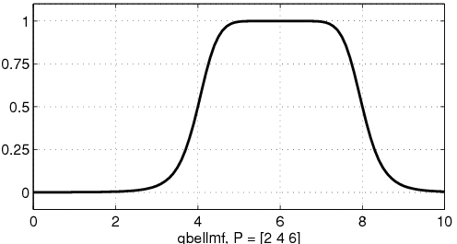

Sonar Model
Some useful functions

Slide 22
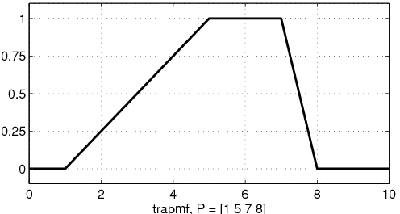

Sonar Model
Some useful functions
a
b
c
d

Slide 23
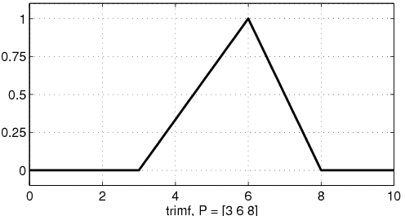
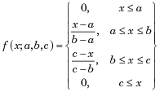
Sonar Model
Some useful functions
a
b
c

Slide 24

Sonar Model
Some useful functions
y
(x_{n},y_{n})
y
(x_{n-1},y_{n-1})
x
x

Slide 25
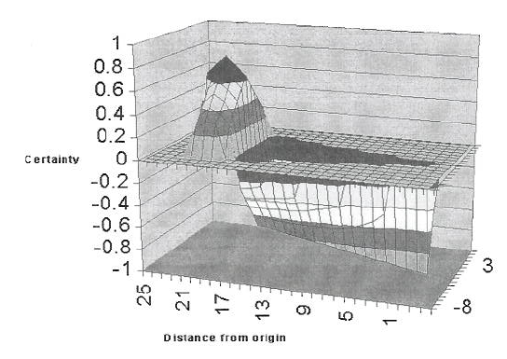
Sonar Model
Example from Murphy page 379

Slide 26
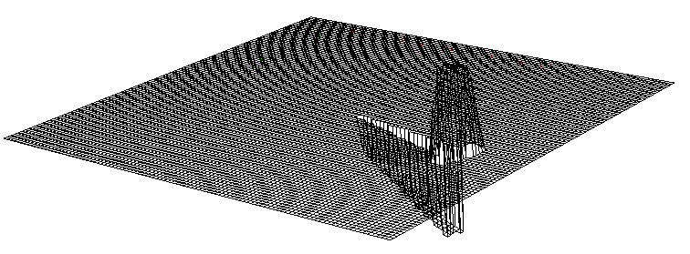
Sonar Model
Example from me

Slide 27
Sonar Model
How to get create a model like this?
Use parametric functions
Bell curve
Triangle
Trapezoid
Parameters
Angle
Distance
Combine these functions and plot in polar space

Slide 28
Sonar Model
Example using linear interpolation
Use two linear functions of distance for m and e
Interpolate across these for angle
e
3000mm
m
β
β
d
e

Slide 29
Sonar Model
Function m
Points = {(0,0),(max(0,d-150),0.25), (d,1.0), (min(d+150,3000),0.5), (3000,0.5)}
P
1
0.5
0.25
150
Dist
0
d
3000

Slide 30
Sonar Model
Function e
Points = {(0,0.4),(max(0,d-150),0.5), (d,0.6), (min(d+150,3000),0.5), (3000,0.5)}
P
1
0.6
0.4
0
Dist
d
3000

Slide 31
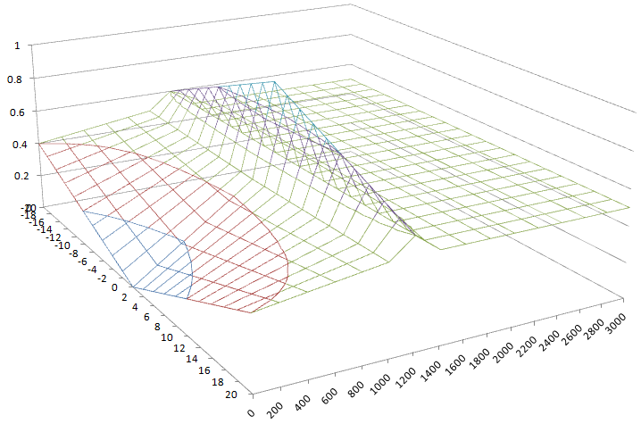
In Cartesian Co-ord Space

